Slide 1
CS3383
Unit, Integration, System Testing
Week 8 Tutorial

Slide 3
Recalling from Lecture Note
11

Slide 4
Testing Stages for Programs written in Procedural Language (e.g., C)
test each node
Unit Testing
  Test a procedure/function independently from others
  E.g., Test against purpose of the procedure/function
Integration Testing
  Test the interconnection of a set of procedures/functions
  E.g., Test against the purpose of the group and their interactions
System Testing
  Test the entire program (all methods together)
  E.g., Test against the requirements
test each edge

Slide 5
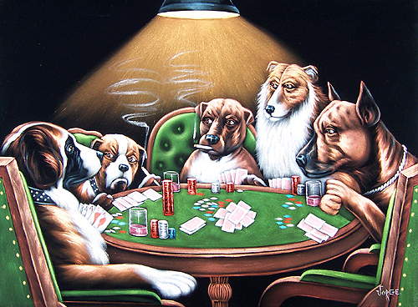
Case Study – The Poker Game
Background
  A player is given a hand, namely 5 distinct poker cards, from a deck of 52 distinct cards
    13 cards: A, 2, 3, 4, 5, 6, 7, 8, 9, X, J, Q, and K
    4 suits: club (C), heart (H), spade (S), and diamond (D)
Programming Requirement
To write a program to determine the scores of a hand of 5cards

Slide 6
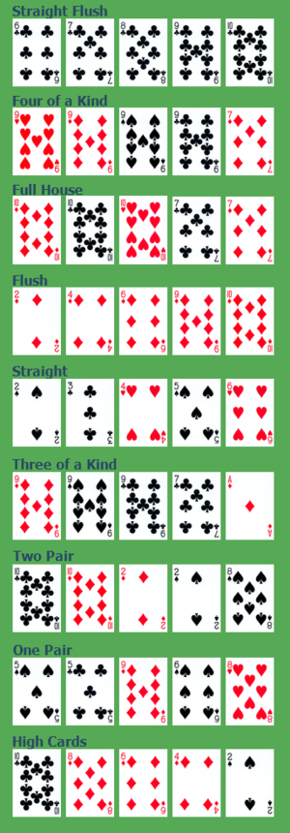
Score Rules [slide 1 of 3]
Straight flush (1000 points)
  five cards of the same suit in sequence
Four of a kind (750 points)
  four cards of the same rank accompanied by another card
Full house (500 points)
  three cards of one rank accompanied by two of another

Slide 7
Score Rules [slide 2 of 3]
Flush (350 points )
  five cards of the same suit
Straight (250 points)
  five cards in sequence
Three of a kind (200 points )
  three cards of the same rank and two additional cards

Slide 8
Score Rules [slide 3 of 3]
Two pairs (100 points )
  two cards of one rank, two cards of another rank and an additional card.
One pair (50 points)
  two cards of one rank accompanied by three additional cards.
High cards (0 point)
  any hand that does not qualify as one of the abovementioned hands.

Slide 9
Sample Input and Corresponding Output
Note: C: Club, D: Diamond,
H: Heart, S: Spade
Input
      3
      C3 D4 D5 S3 CX
      CA C5 D4 H3 S2
      C6 C7 C8 C9 CX
Outputs
      50
      250
      1000
The number of hands provided
Use a blank space to separate two cards
e.g. S2 indicates a spade
card having a rank of 2
e.g. This row indicates 6789X of the club suit

Slide 10
Input and Output
(More detailed explanation)
Input
  The first line contains the number of hands. Then the hands are listed one by one.
    Note that each hand comes from a complete deck of 52 cards.
    Each hand is listed in one line with 5 cards.
    Each card consists of two upper case letters. The first letter is its suit, and the second letter is its rank. There is a blank space between two cards. The cards in one hand are not sorted at all.
Output
  For each hand, output its points in one line.
  If a hand satisfies two or more rules, we only apply the rule that wins the largest amount of points.
    E.g. a “full house” consists of a “three of a kind” and a “one pair.” You need to give the score for “full house” only (i.e., 500 points), and nothing else.

Slide 11
Current System Design
Hierarchy of procedural/function calls
main
sort
score
isStraightFlush
isFourOfaKind
isFullHouse
isOnePair
isFlush
isStraight
isThreeOfaKind
isTwoPairs
For presentation clarity, the above diagram hides the directed lines between “score” and any one of “isFlush”, “isStraight”, “isThreeOfaKind”, and “isTwoPairs”.

Slide 12

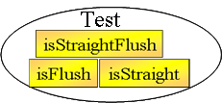
Notes
Situation A: If we want to Test the function isStragithFlush()
  Write a stub (i.e., dummy function) that “hard-code” the returned value of isFlush() for some selected inputs called by isStragithFlush. Write a stub to simulate isStraight() as well.
Situation B: If we want to Test multiple functions at the same time based on how one calls another (the calling relationship is known as dependencies. [Recall design principle in CS3342?])
  Integration Testing

Slide 13

Exercise 1 – (2 min.)
What is the testing stage illustrated by the above situation?
  Unit Testing
  Integration Testing
  System Testing
Do we need to create any stub for the above situation?

Slide 14
Exercise 1 - sol
What is the testing stage in the above situation?
  Unit Testing
  Integration Testing
  System Testing
Yes, test Stubs are required.

Slide 15
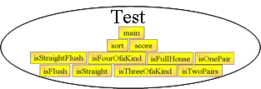
Exercise 2 – (2 min.)
What is the testing stage in the above situation?
  Unit Testing
  Integration Testing
  System Testing
Do we need to create any test stub for the above situation?

Slide 16
Exercise 2 - sol
What is the testing stage in the above situation?
  Unit Testing
  Integration Testing
  System Testing
No stub is required.

Slide 17

Exercise 3 – (2 min.)
What is the testing stage in the above situation?
  Unit Testing
  Integration Testing
  System Testing
Do we need to create any stub for the above situation?

Slide 18
Exercise 3 - sol
What is the testing stage in the above situation?
  Unit Testing
  Integration Testing
  System Testing
Stubs to simulate SORT and SCORE are required.

Slide 19

Exercise 4 – (2 min.)
What is the testing stage in the above situation?
  Unit Testing
  Integration Testing
  System Testing
Do we need to create any stub for the above situation?

Slide 20
Exercise 4 - sol
What is the testing stage in the above situation?
  Unit Testing
  Integration Testing
  System Testing
Stubs are required.

Slide 21
Exercise 5 – (15 min.)
Given the current system design of Poker Game.
In each testing level, which functions will be tested?
  E.g., will you test the isStraightFlush function independently? Or test it with other methods together?
What is the sequences of test that you will conduct?
  Which function(s) will you test it (them) first?
  E.g., Test the main function independently as the first step? Or test the isStraightFlush, isStraight and isFlush functions together before testing main? Which function(s) to test in the 2nd step, 3rd step, and on?

Slide 22
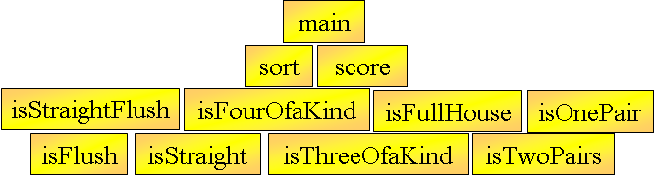
Exercise 5
[Reference Solution 1: Top-down Approach]
Test the functions from high to low levels
Unit Testing
Test
main
Test
Integration Testing
Test
System Testing
Test

Slide 23


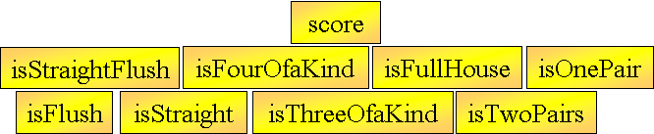
Exercise 5
[Reference Solution 2: Bottom-up Approach]
Test the functions from low to high levels
Test
Test
Test
Unit Testing
sort
isFourOfaKind
isOnePair
Test
Test
Test
Test
isFlush
isStraight
isThreeOfaKind
isTwoPairs
Test
Test
Integration Testing
Test
System Testing
Test

Slide 24
Exercise 5
[Reference Solution 3: Big-bang Approach]
Test all functions in isolation, and integrate them altogether when we test the system as a whole
Test
Test
Test
main
sort
score
Unit Testing
Test
Test
Test
Test
isStraightFlush
isFourOfaKind
isFullHouse
isOnePair
Test
Test
Test
Test
isFlush
isStraight
isThreeOfaKind
isTwoPairs
Integration Testing
System Testing
Test

Slide 25
Exercise 5
[Reference Solution 4: Sandwich Approach]
Uses top-down tests for upper levels, coupled with bottom-up tests for lower levels
Bottom-up
Top-down
Test
Test
isOnePair
Unit Testing
Test
Test
Test
Test
main
Test
isFlush
isStraight
isThreeOfaKind
isTwoPairs
isFourOfaKind
Test
Integration Testing
Test
Test
Test
Score
isFourOfaKind
isOnePair
System Testing
Test

Slide 26
Sandwich Integration Testing
A
A
Top-down
B1
B2
B1
B2
C2
C4
C2
C4
C1
C3
Bottom-up
C1.1
C1.2
C3.1
C3.2
C1.1
C1.2
C3.1
C3.2
A
Sandwich/combine
B1
B2
C1
C2
C3
C4
C1.1
C1.2
C3.1
C3.2

Slide 27
Modified Top-Down
Integration Testing
A
B1
A
C1
C3
unit
B2
C2
C4
B1
B2
unit
integrate
unit
A
C1.1
A
B1
B2
integrate
C1.2
C1
C2
C3
C4
B1
B2
C3.1
C1
C2
C3
C4
C1.1
C1.2
C3.1
C3.2
C3.2
system
unit

Slide 28
TESTING WITH OPENCODE
Apply the testing levels to PokerGame
Testing level | What the test checks
Unit | Check a function; replace dependencies when isolating a caller.
Integration | Connect real functions and check their interaction.
System | Run the complete scoring flow against the requirements.

Slide 29
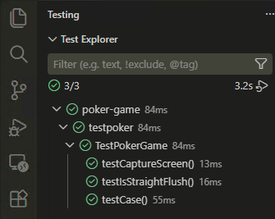
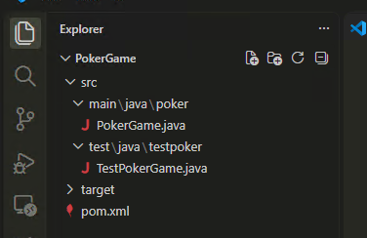
GETTING STARTED
Open the supplied PokerGame Java project
PokerGame/
pom.xml
src/main/java/poker/PokerGame.java
src/test/java/testpoker/TestPokerGame.java
Extract `CS3383_Week08_Tutorial_Code.zip`. In VS Code: File → Open Folder → PokerGame. Keep pom.xml in this root. Open the integrated terminal, start opencode.

Slide 30
READ THE STARTER TESTS
Existing unit and system tests
Unit: stubbed dependencies
System: real call chain
class StubPokerHand extends PokerGame {
public boolean
isStraight(String hand) {
return true;
}
public boolean
isFlush(String hand) {
return false;
}
}
String[] args = { "3",
"C3 D4 D5 S3 CX",
"CA C5 D4 H3 S2",
"C6 C7 C8 C9 CX" };
PokerGame poker = new PokerGame();
poker.main(args);
testIsStraightFlush() isolates the real caller with two stubbed dependencies. testCaptureScreen() uses real methods and asserts outputs 50, 250 and 1000.
testCase() is empty; only two existing tests contain assertions.

Slide 31
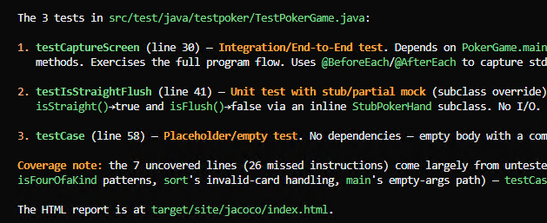
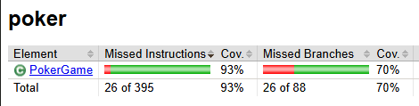
BASELINE
Record the baseline
Copy this prompt to OpenCode in Build Mode
Run tests and generate JaCoCo coverage. Classify the existing tests by their dependencies. Do not edit files.

Slide 32
BASELINE
Six scores remain unchecked
Required score | Valid hand to test
Four of a kind · 750 | C3 D3 H3 S3 C7
Full house · 500 | C3 D3 H3 C7 D7
Flush · 350 | C2 C4 C6 C8 CQ
Three of a kind · 200 | C3 D3 H3 C7 D9
Two pairs · 100 | C3 D3 C7 D7 H9
High card · 0 | C2 D4 H6 S8 CQ
The existing output test checks only one pair, a straight and a straight flush.
Every method runs at least once, yet these six scores are never asserted.

Slide 33
UNIT TESTING
Check functions before combining them
Test sort(), isStraight() and isFlush() directly. For an isolated isStraightFlush() test, override its two dependencies as in the supplied stub.
Function under test | Input / controlled dependency → expected result
sort | CX C6 C9 C7 C8 → C6C7C8C9CX
isStraight / isFlush | C6C7C8C9CX → true / true
isStraightFlush | Straight=true, Flush=true → true
isStraightFlush | Straight=true, Flush=false → false
isStraightFlush | Straight=false → false

Slide 34
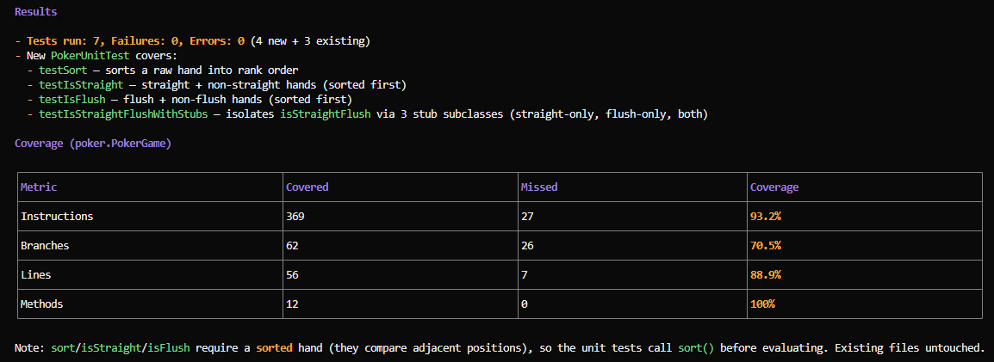
UNIT TESTING
Add the unit tests
Copy this prompt to OpenCode in Build Mode
Add PokerUnitTest: test sort, isStraight and isFlush directly; isolate isStraightFlush with stubs. Preserve existing files. Run tests.

Slide 35
INTEGRATION TESTING
Connect the real functions
Now call isStraightFlush() with the real isStraight() and isFlush().
Then connect sort() to score(). Use no stubs.
Real combination | Expected result
isStraightFlush("C6C7C8C9CX") | true: straight and flush
isStraightFlush("C2D3H4S5C6") | false: straight only
isStraightFlush("C2C4C6C8CQ") | false: flush only
score(sort("CX C6 C9 C7 C8")) | 1000: sorting and scoring agree

Slide 36
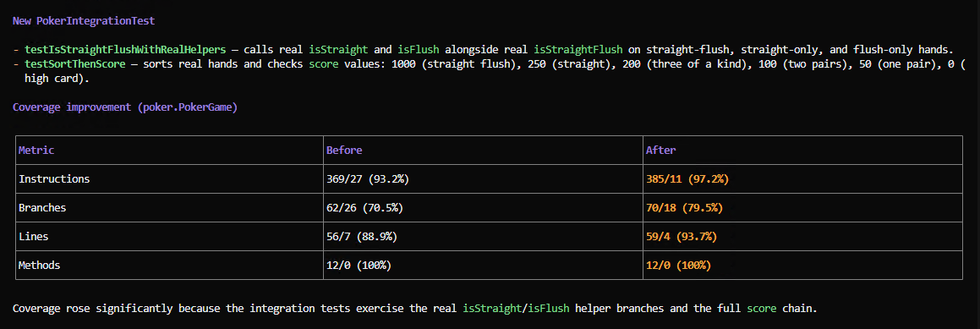
INTEGRATION TESTING
Add the integration tests
Copy this prompt to OpenCode in Build Mode
Add PokerIntegrationTest using real methods: isStraightFlush with its helpers, then sort with score. No stubs. Run tests.

Slide 37
SYSTEM TESTING
Test the complete input and output
Use the existing instance method main(String[] args). It reads the argument array. (This starter does not read cards from standard input.)
Use all real methods. Capture System.out, compare the complete output, and restore the original stream after the test.
new PokerGame().main(new String[] {
"1", "CX C6 C9 C7 C8"
});
Expected output: "1000" + System.lineSeparator()
main → sort → score → real card checks → output

Slide 38
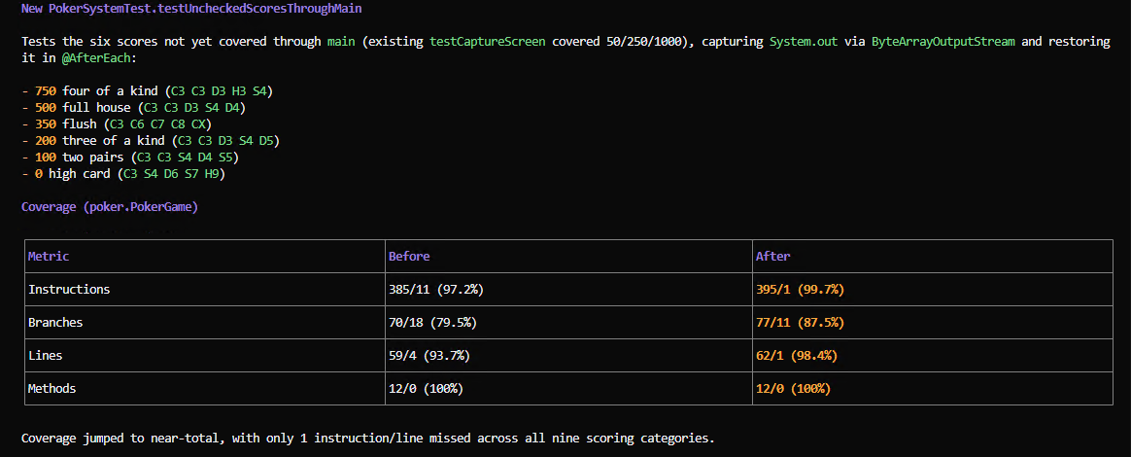
SYSTEM TESTING
Extend the system tests
Copy this prompt to OpenCode in Build Mode
Add PokerSystemTest for the six unchecked scores through main. Capture and restore System.out. Use all real methods. Preserve existing files. Run tests.

Slide 39
TESTING LEVELS
Classify the testing levels
Test boundary | Level and what it establishes
isStraightFlush with two stubs | Unit: the caller combines controlled results correctly.
isStraightFlush with real helpers | Integration: the real functions work together.
sort followed by real score | Integration: the two functions agree on hand format.
main with the full real call chain | System: complete input produces the required output.
In this practical, the integration order builds upward from the lower-level functions.
This is the bottom-up approach discussed earlier.

